Slide 1

The Nirvista Ecosystem
A blockchain-powered digital economy connecting commerce, travel, and global financial infrastructure through seamless payments and tokenized value exchange.

Slide 2

Why Ecosystems Drive Blockchain Adoption
Successful blockchain platforms don't rely on single products—they create self-sustaining digital economies where multiple services reinforce each other's value.
The Nirvista ecosystem mirrors the super-app strategy used by tech giants like Alibaba, Tencent, and Amazon, building network effects that compound with every new user and transaction.

Slide 3
Nirvista Global Wallet & Payment System
Foundation of the Entire Ecosystem
Store Value
Send Payments
Securely hold Nirvista Coin and manage multiple currencies in one unified wallet
Transfer money internationally in seconds with minimal fees
Convert Assets
Pay Merchants
Seamlessly swap between fiat and cryptocurrency at competitive rates
Settle purchases across all Nirvista platforms instantly
The wallet serves as the financial infrastructure layer powering every transaction in the ecosystem. Adoption impact: Very High — payments drive daily usage and create the user base for all other services.

Slide 4

Nirvista E-commerce Platform
For Buyers
For Merchants
Shop products from global merchants
Pay with Nirvista Coin or fiat
Earn cashback rewards in cryptocurrency
Enjoy low cross-border transaction fees
Reduced payment processing costs
Access to global customer base
Instant settlements without intermediaries
Lower fraud risk with blockchain verification
Adoption impact: High — e-commerce generates frequent transactions and continuous token circulation throughout the ecosystem.

Slide 5


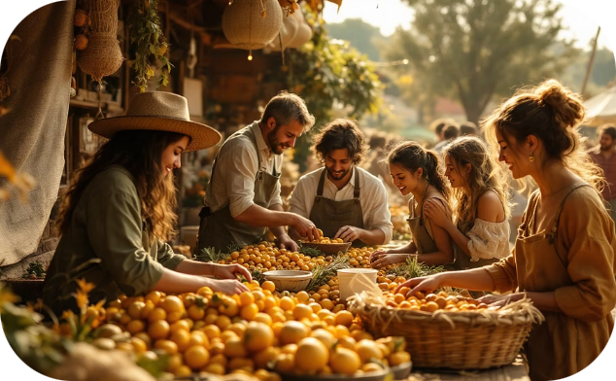
Nirvista Travel Platform
Real-World Global Utility
Flights
Hotels
Experiences
Book flights worldwide using Nirvista Coin and earn loyalty rewards on every journey
Reserve accommodations globally with instant cryptocurrency payments and exclusive member rates
Discover tours, activities, and local services with seamless crypto-powered bookings
Travel users are international by nature, making them ideal early adopters of global payment infrastructure. The platform creates real-world utility while travelers use the wallet for everyday expenses abroad.
Adoption impact: Medium to High — travel naturally involves international payments and cross-border value transfer.

Slide 6
Which Platform Drives Mass Adoption Fastest
3. Travel Platform
2. E-commerce Platform
Global Exposure — Travel users naturally operate internationally, making them perfect early adopters. This platform helps the ecosystem expand globally and build credibility.
1. Global Wallet & Payments
Transaction Volume — E-commerce creates daily transactions. Every purchase becomes a blockchain transaction, increasing network activity and token circulation exponentially.
Most Important — Mass adoption begins with payments. If users can send money internationally instantly and cheaply, they'll adopt the wallet first, creating a global user base that fuels everything else.

Slide 7
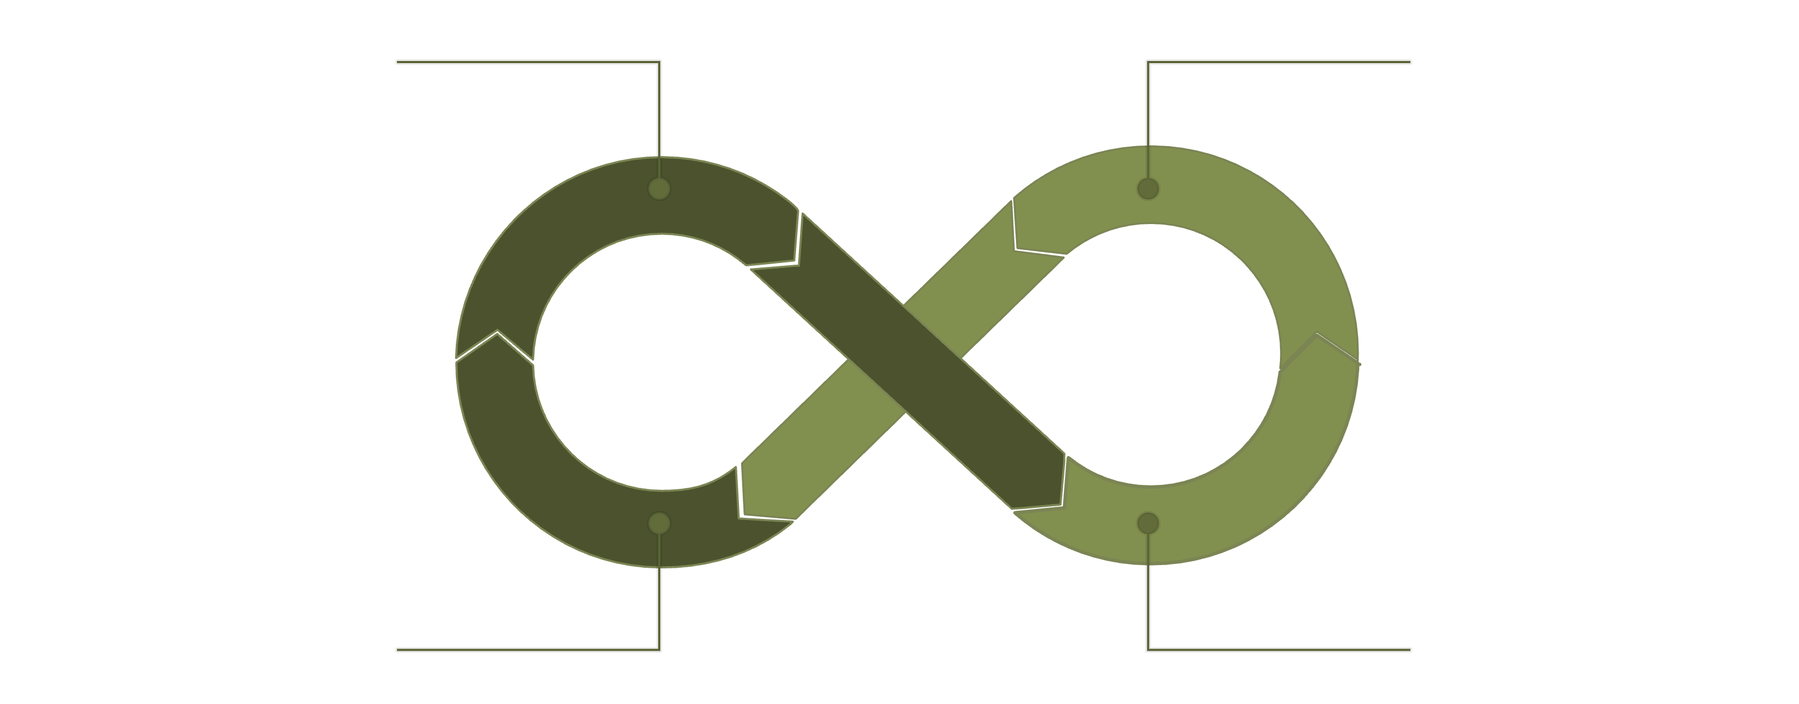
The Network Effect
A Closed-Loop Digital Economy
Users Earn Nirvista Coin
Spend on Commerce & Travel
Blockchain Processes Payments
Merchants Accept Coin

Slide 8
Ecosystem Growth Strategy
Accelerating Mass Adoption
1
2
3
Cashback Rewards
Merchant Incentives
Freelancer Support
Users earn Nirvista Coin on every purchase, creating incentive loops that drive repeat usage and token accumulation
Lower fees and instant settlements attract merchants to accept Nirvista Coin, expanding payment acceptance
Enable global payment infrastructure for digital workers, solving cross-border remittance pain points
4
5
Travel Loyalty
Platform APIs
Integrate rewards programs that convert travel activity into token holdings and ecosystem engagement
Provide integration tools for third-party platforms to accept payments and extend ecosystem reach

Slide 9
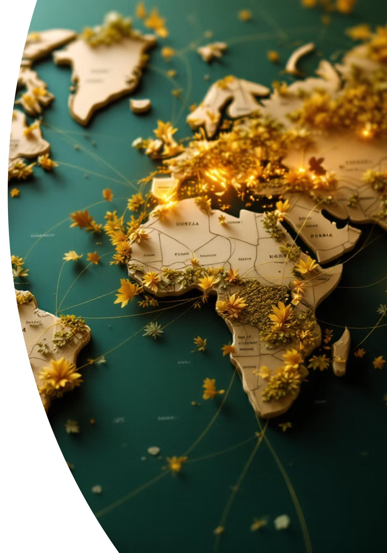
Real-World Use Cases & Initial Markets
Daily Utility
Target Markets
Freelancer payments across borders
Global remittances without intermediaries
E-commerce purchases with crypto rewards
Travel bookings with loyalty points
Cross-border business settlements
India — High remittance volume
United States — Tech adoption
United Arab Emirates — Crypto-friendly
Vietnam — Digital commerce growth
These markets offer strong demand for cross-border payments and digital commerce, providing ideal conditions for ecosystem expansion and rapid user growth.

Slide 10
Building a Global Digital Financial Ecosystem
Instant Cross-Border Payments
Global Commerce Operations
Money moves instantly across borders without traditional banking friction
Buy and sell products worldwide with unified payment infrastructure
Seamless Travel Experience
Universal Financial Access
Book and pay for travel with cryptocurrency while earning rewards
Democratize access to financial services for billions underserved by traditional banking
Nirvista Ecosystem — Connecting commerce, travel, and global payments through blockchain technology. Simplifying global finance for a connected world.

