Slide 1
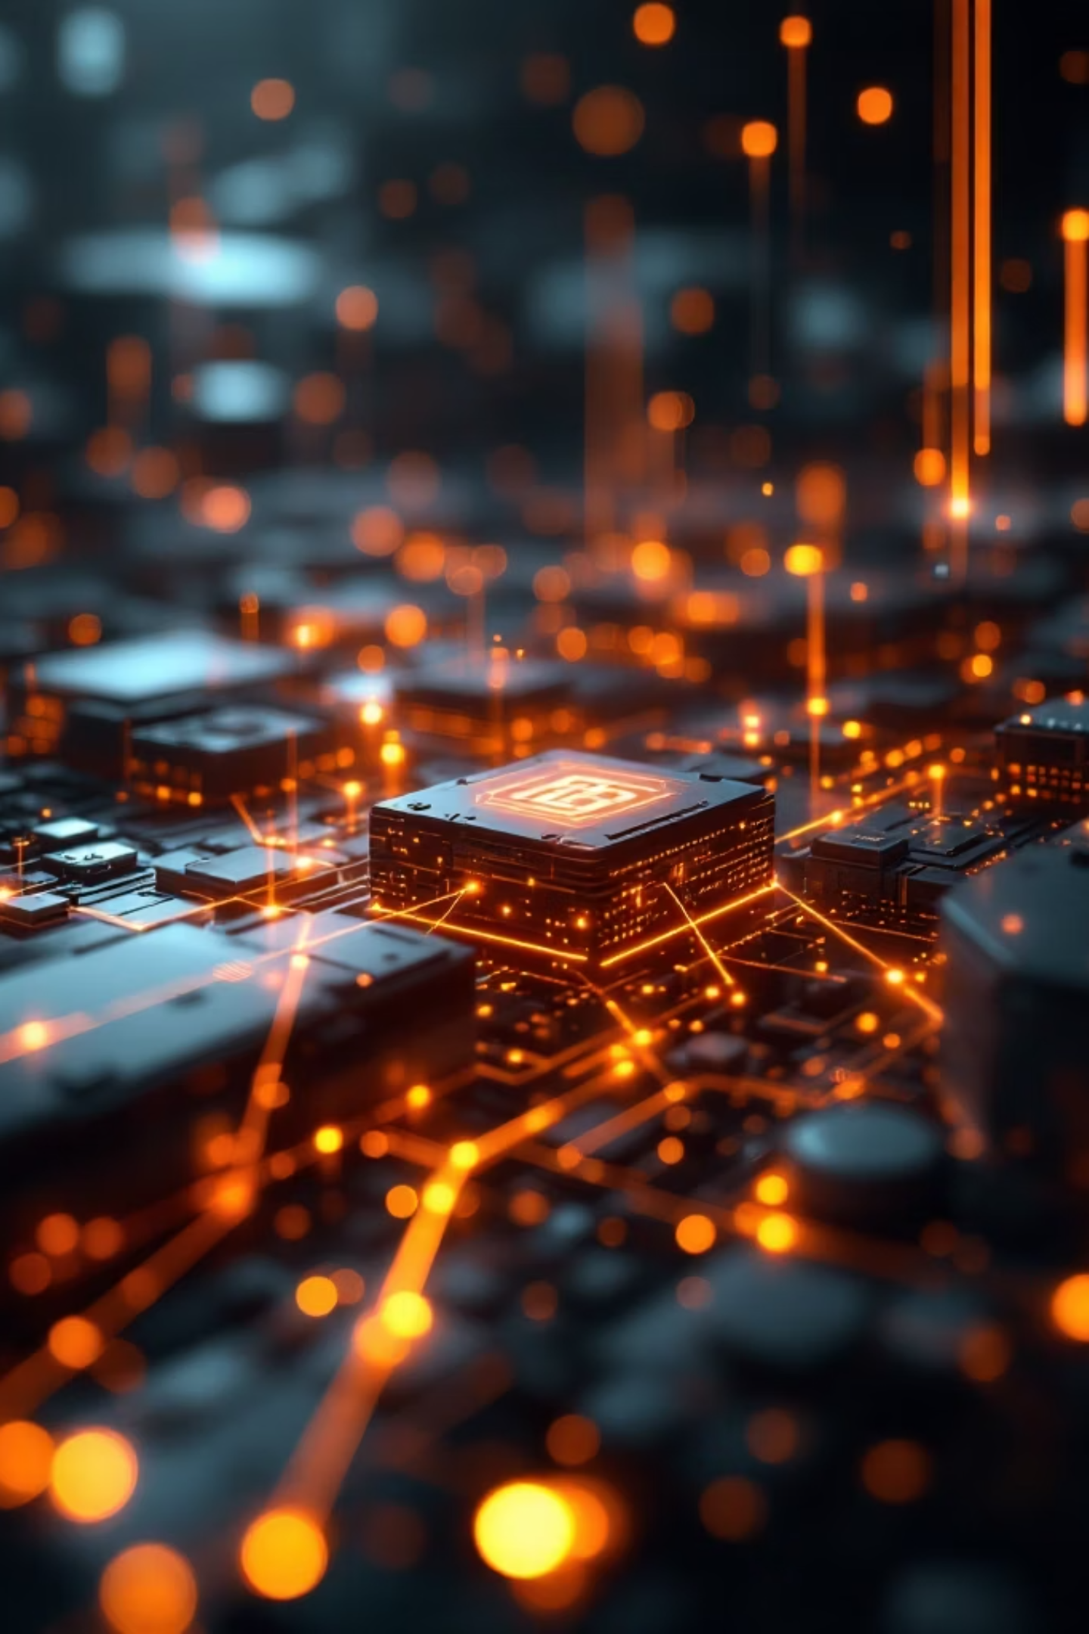
NirvPay Token
The ecosystem token powering Nirvista's global expansion and community-driven growth

Slide 2
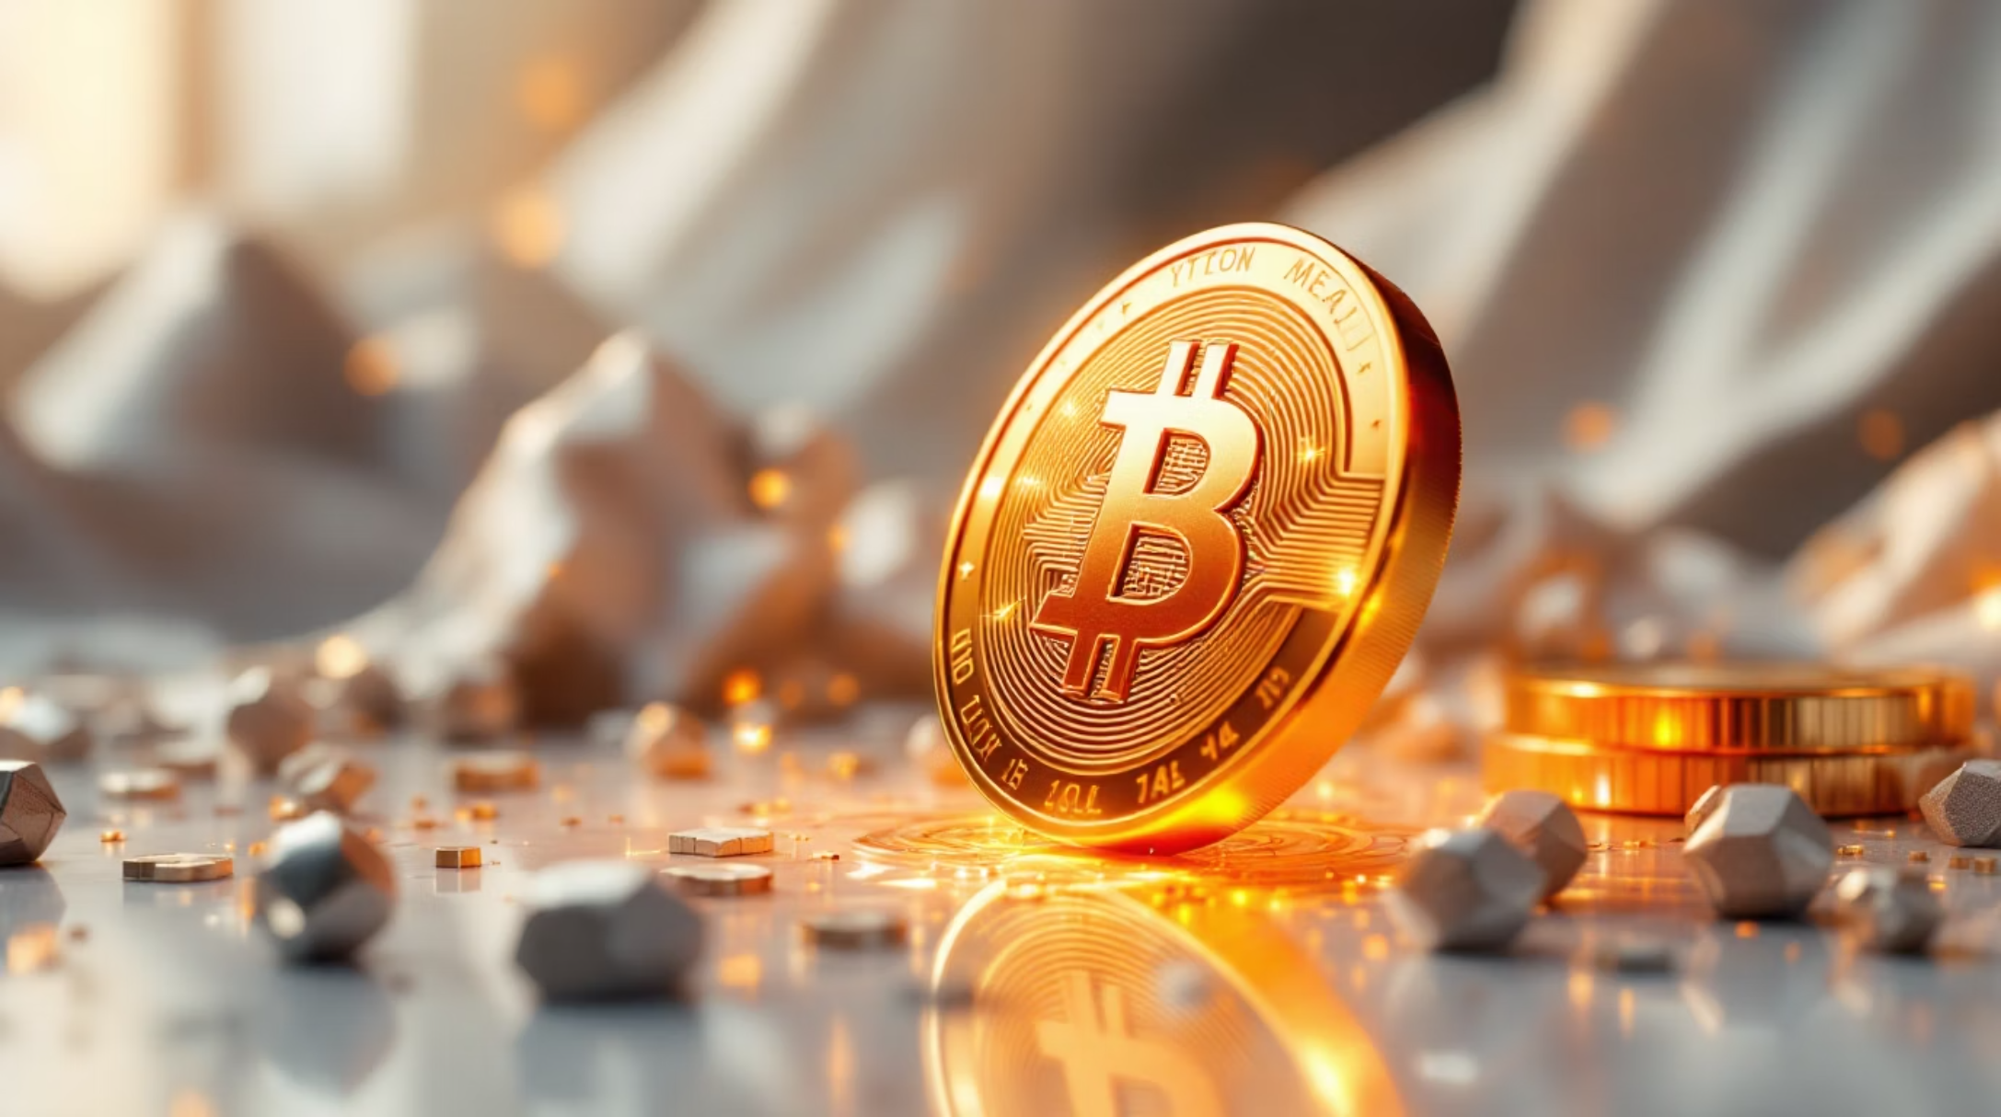
What is NirvPay Token?
NirvPay Token (NVP) is the ecosystem token designed to fuel the initial growth and expansion of the Nirvista Blockchain ecosystem.
Introduced through Pre-ICO and Initial Coin Offering (ICO) phases, this token serves as a secondary transaction and incentive mechanism within the broader ecosystem.
Funds raised support critical development initiatives including blockchain infrastructure, platform expansion, and global adoption campaigns.

Slide 3
Three Core Purposes
Fundraising Mechanism
Incentive Token
Ecosystem Growth Engine
Enables capital raising for infrastructure development through pre-ICO and ICO phases
Rewards ecosystem participants including affiliate partners, referrers, platform promoters, and early adopters
Encourages platform adoption through token-based incentives and community rewards programs

Slide 4
Dual-Token Architecture
The Nirvista ecosystem operates with two distinct digital assets, each serving a specific purpose.
Nirvista Coin
NirvPay Token
Primary blockchain currency for global payments, transaction settlement, merchant transactions, and core ecosystem operations
Secondary ecosystem token for fundraising, rewards, affiliate programs, referral incentives, and community engagement initiatives
This dual-token structure strategically separates utility payments from ecosystem incentives, creating a balanced economic model.

Slide 5




Fundraising Roadmap
Phase 1: Private Sale
Early strategic investors and key partners
Phase 2: Pre-ICO
Public early supporters and community builders
Phase 3: ICO
Global token sale for large-scale ecosystem development
Raised funds primarily support blockchain development, infrastructure expansion, platform development, and marketing initiatives.

Slide 6

Affiliate & Referral Programs
Community-Driven Growth Model
NirvPay Token powers the Nirvista Affiliate and Referral System, enabling users to earn rewards through:
Inviting new users to the ecosystem
Promoting Nirvista platforms
Merchant onboarding programs
Active community participation
This creates a self-sustaining growth engine driven by token-based incentives.

Slide 7
Secondary Transaction Layer
NirvPay Token functions as a secondary transaction token within the ecosystem, distinct from primary payment currency.
Reward Distribution
Loyalty Incentives
Systematic allocation of tokens to ecosystem participants based on engagement and contribution metrics
Ongoing rewards for sustained platform usage and continued ecosystem participation
Affiliate Commissions
Promotional Campaigns
Percentage-based earnings for successful referrals and merchant partnerships
Targeted incentive programs to drive specific adoption and engagement goals

Slide 8

Developer Ecosystem Support
01
02
Development Grants
Ecosystem Rewards
Funding for developers building innovative applications on Nirvista Blockchain
Token incentives for successful platform integrations and ecosystem contributions
03
Application Incentives
Rewards for creating tools, services, and platforms that enhance ecosystem value
This approach builds a thriving developer ecosystem around Nirvista Blockchain technology.

Slide 9




Ecosystem Value Flow
User Engagement
Token Rewards
Users participate through platform usage and referrals
NirvPay Token distributed as incentives
Ecosystem Growth
Platform Usage
Expanded user base and merchant adoption
Nirvista Coin used for transactions
Together, these complementary assets create a balanced economic model for sustainable ecosystem expansion.

Slide 10
Long-Term Vision
Global User Acquisition
Worldwide platform adoption through targeted incentive programs
Merchant Adoption
Expanded merchant network accepting ecosystem payments
Developer Ecosystem
Thriving community building innovative applications
Community Expansion
Self-sustaining growth through network-driven incentives
By aligning incentives across all ecosystem participants, NirvPay Token plays a crucial role in the growth and sustainability of Nirvista Blockchain.

