Slide 1

Nirvista
Building the Future of Global Financial Infrastructure
Technology • Innovation • Global Connectivity

Slide 2
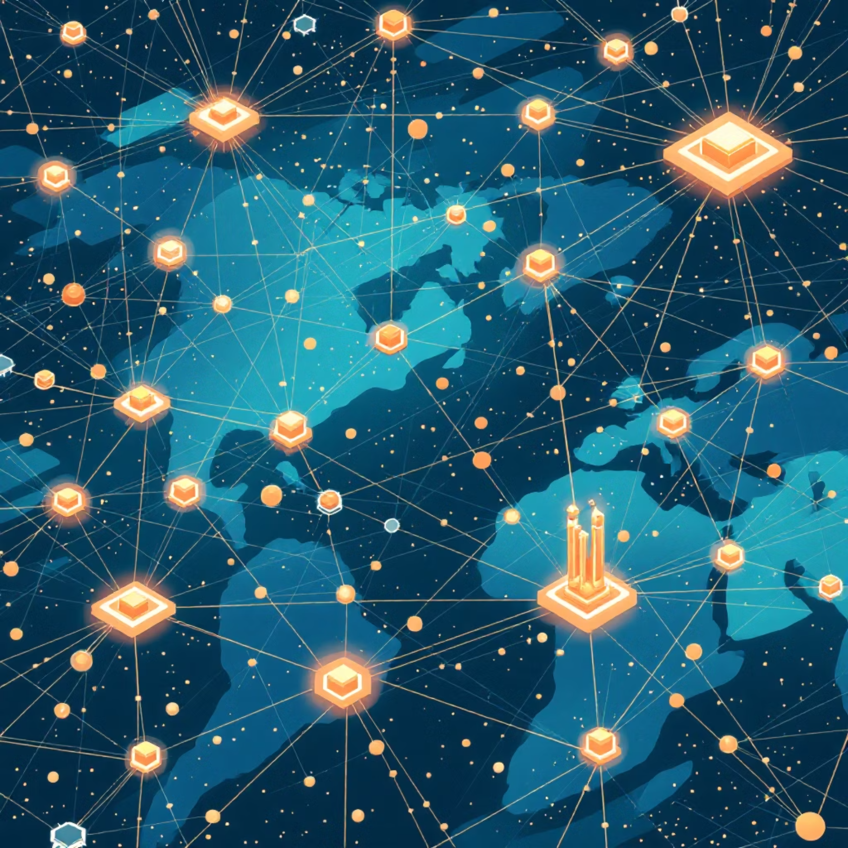
About Nirvista
Nirvista is a technology-driven company founded in 2018 with the vision of building innovative digital solutions that simplify complex systems across industries. What started as a small software development company has evolved into a multi-domain technology organization working across fintech, artificial intelligence, blockchain technology, and digital infrastructure.
Today, Nirvista focuses on building scalable global platforms that improve financial access, connectivity, and digital transformation worldwide.

Slide 3

The Nirvista Journey
1
2018 – Foundation
Founded as a software development company
2
Early Stage
Delivered custom software solutions and built strong engineering capabilities
3
Expansion Phase
Expanded into fintech, artificial intelligence, and blockchain technologies
4
Global Growth
Established international presence and began building global digital infrastructure

Slide 4
Technology Capabilities
Software Development
Fintech
Web applications
Mobile applications
Digital platforms
Enterprise solutions
Digital payment systems
Financial platforms
Cross-border transactions
Artificial Intelligence
Blockchain
Intelligent automation
AI-powered platforms
Data-driven systems
Decentralized applications
Smart contracts
Blockchain infrastructure

Slide 5

Technology for Social Good
Nirvista also focuses on technology-driven social initiatives aimed at improving digital inclusion and supporting community development.
Key initiatives include:
Digital access programs
Technology education
Community-focused digital platforms
Social innovation projects

Slide 6
International Operations
Nirvista's international presence allows the company to build globally scalable technology solutions and serve clients across multiple regions.
India
United States
Technology development and digital payments innovation
Enterprise fintech solutions and AI research
United Arab Emirates
Vietnam
Blockchain infrastructure and financial technology
Software development and digital platform services

Slide 7
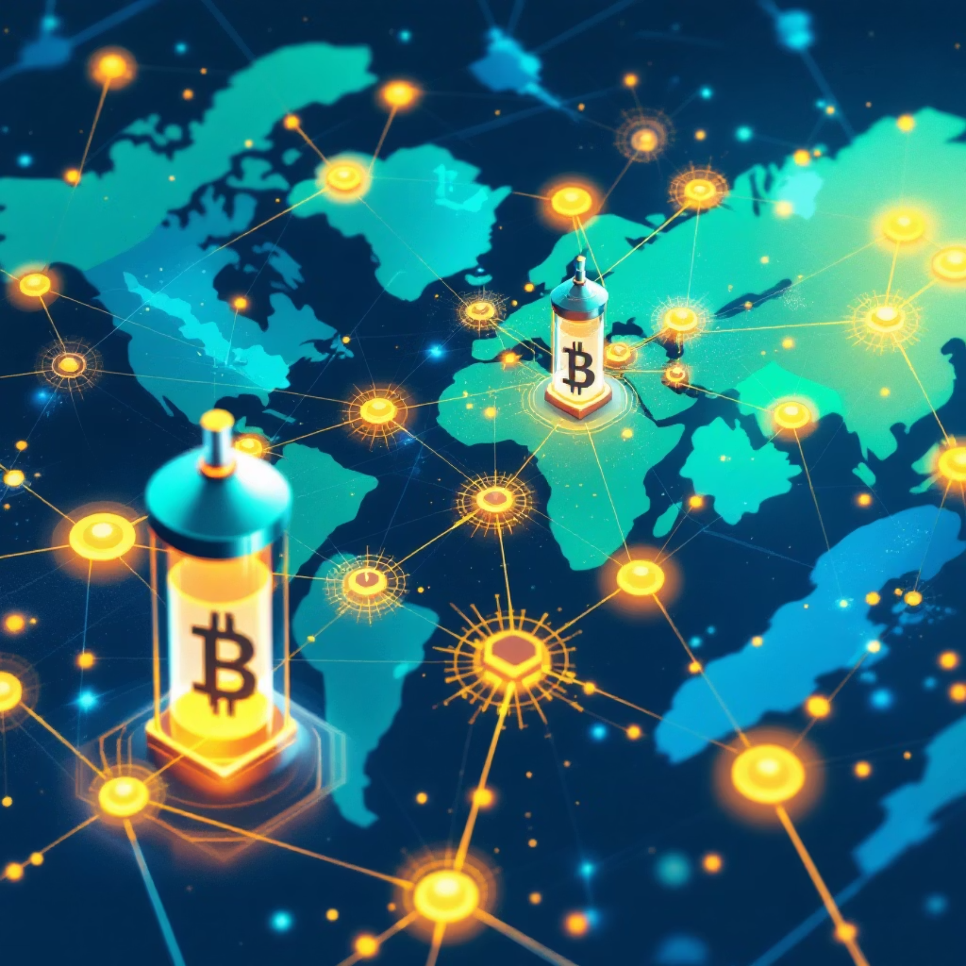
Building the Future of Global Payments
Nirvista has been developing a blockchain-based global payment ecosystem for the past six months. The purpose is to make cross-border financial transactions as simple, fast, and accessible as domestic digital payments.

Slide 8
Challenges in Cross-Border Transactions
High Transaction Fees
Slow Processing Times
Multiple Intermediary Banks
International transfers often incur excessive costs that burden individuals and businesses
Traditional banking systems can take days to complete cross-border transactions
Complex network of banks increases costs and delays
Complex Financial Infrastructure
Limited Access
Individuals and small businesses often lack access to international payment systems
Different regulations, currencies, and systems create barriers

Slide 9





The Nirvista Global Payment Ecosystem
Nirvista is building a blockchain-powered platform that enables:
Instant Global Transactions
Lower Transaction Costs
Secure Financial Infrastructure
Reduced Intermediaries
Accessible Digital Payments Worldwide

Slide 10
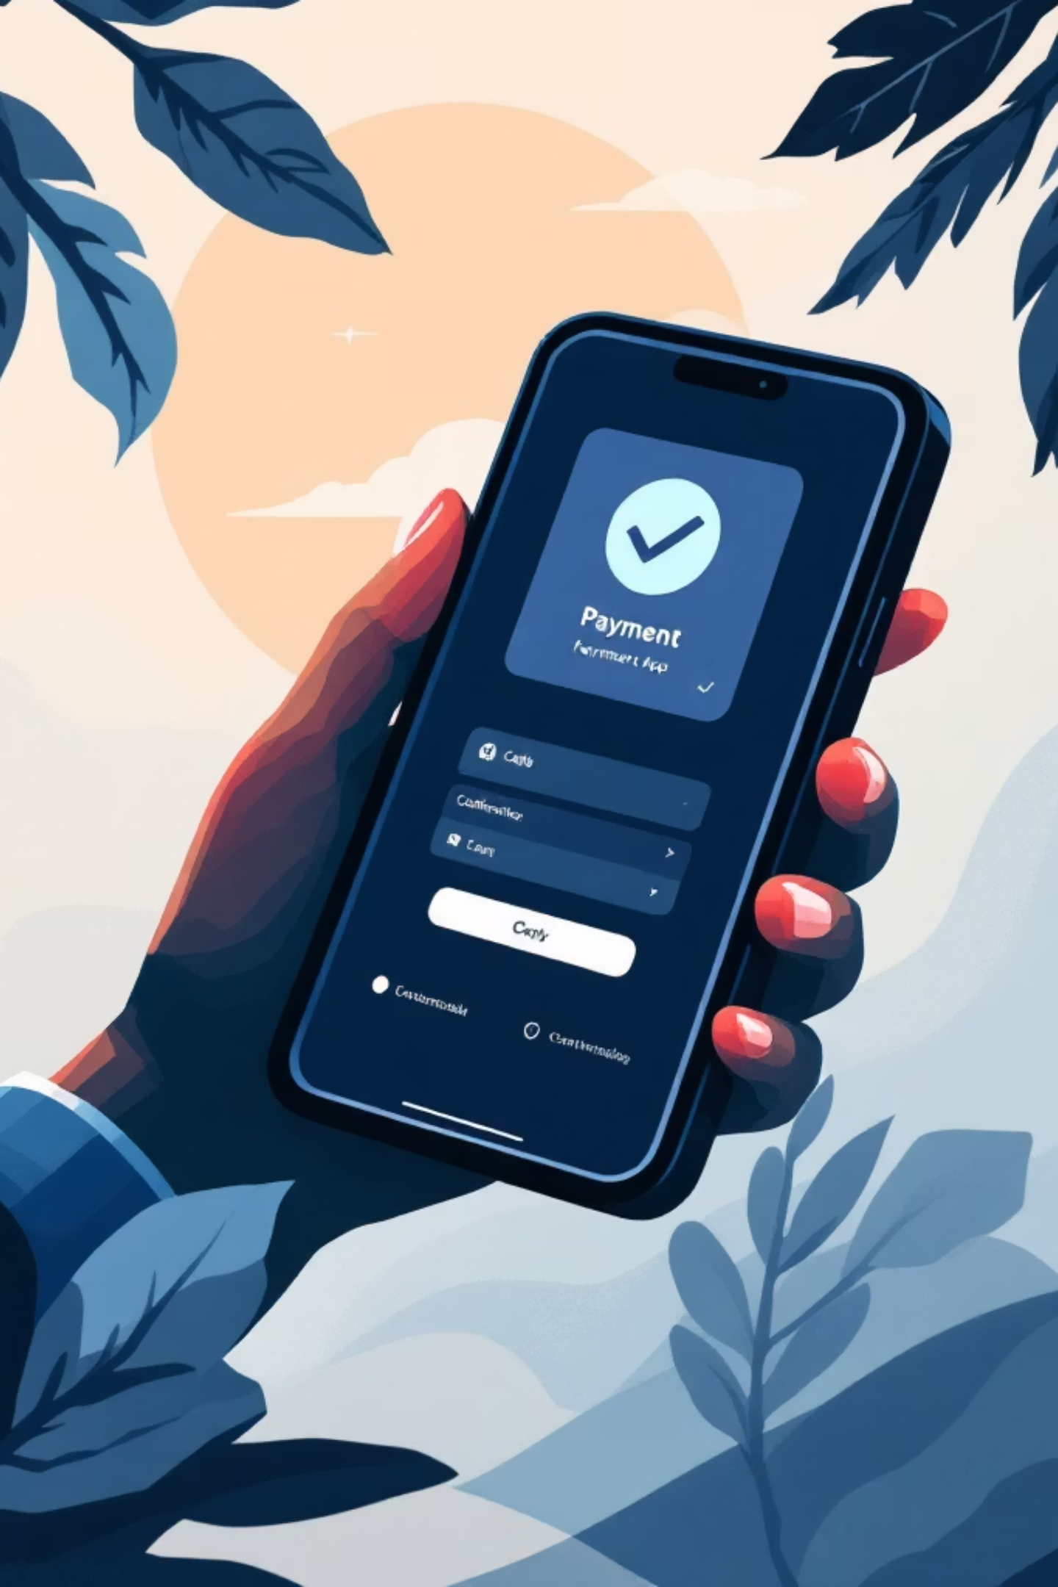
Simplicity of Domestic Payments
Domestic payment systems have made payments extremely simple. Nirvista's goal is to bring the same simplicity to international transactions.
India – UPI
Unified Payments Interface revolutionized domestic transactions with instant, seamless payments
United States – Venmo
Peer-to-peer payments made simple and social for everyday transactions

Slide 11
Blockchain-Powered Platform
Nirvista's platform leverages blockchain technology to deliver unparalleled advantages in cross-border transactions:
Transparent Transactions
Secure Decentralized Network
Reduced Intermediaries
All transactions are recorded on an immutable ledger, providing full visibility and trust.
Cryptography and distributed ledger technology ensure data integrity and protection against fraud.
Direct peer-to-peer transfers eliminate the need for multiple banks, simplifying the process.
Faster Settlement Times
Lower Operational Costs
Transactions are processed and settled in minutes, not days, enabling real-time global payments.
Efficiency gains from automation and reduced overhead translate to significant cost savings.

Slide 12
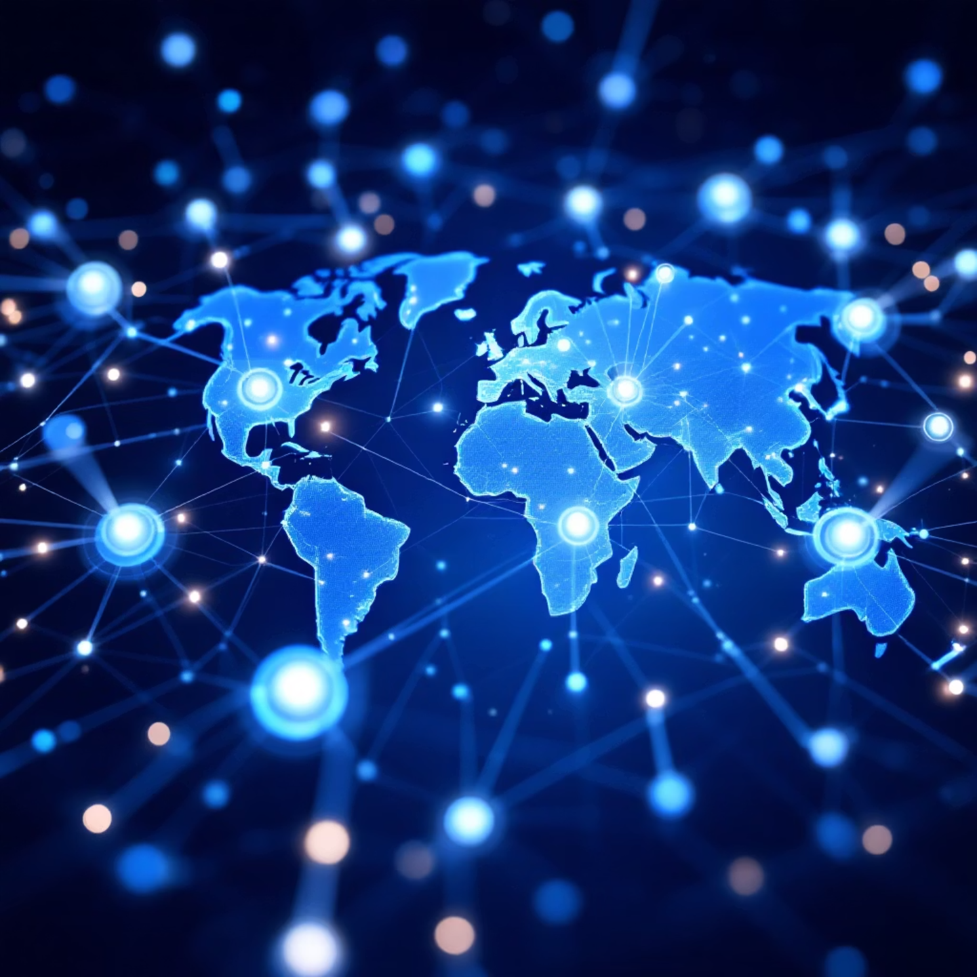
The Future of Global Finance
Nirvista's long-term vision is to reshape the global financial landscape, making cross-border transactions seamless and universally accessible. We are building the infrastructure for a truly connected world economy.
Unified Global Network
Building a singular, cohesive payment network that transcends geographical and institutional barriers.
Borderless Transactions
Enabling individuals and businesses to conduct financial transactions without friction, delays, or excessive costs.
Empowering Global Users
Supporting businesses and individuals worldwide with inclusive financial tools and services.
Next-Gen Infrastructure
Leveraging cutting-edge AI and blockchain technologies to power the financial systems of tomorrow.

Slide 13
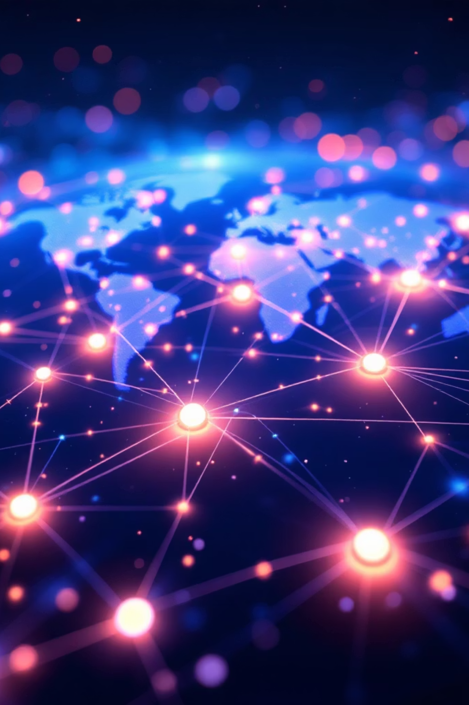
Nirvista Mission
Mission
To simplify global financial systems and build technology platforms that enable seamless international connectivity.
Vision
To create accessible digital infrastructure that powers the future of global finance, fostering economic growth and inclusion.

Slide 14
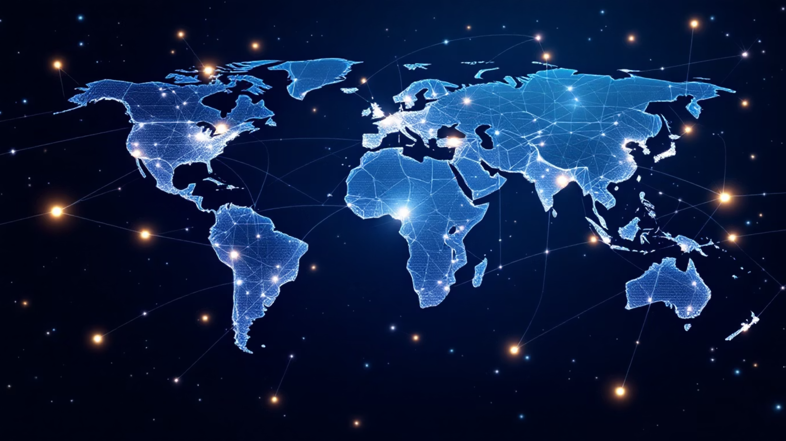
Nirvista
Simplifying Global Finance Through Technology
Building the next generation of global financial infrastructure — enabling seamless, secure, and borderless digital transactions for businesses and individuals worldwide.
Global PresenceIndia • United States • United Arab Emirates • Vietnam
Thank You

