Slide 1

Infinity 8: Building a Sustainable Digital Ecosystem
How strategic investments, community participation, and multi-industry revenue streams create lasting value in the Nirvista ecosystem.

Slide 2

A Different Approach to Growth
Traditional Marketing
Infinity 8 Model
Companies spend 20-40% of revenue on advertising networks, agencies, and promotional campaigns with limited direct community engagement.
Redirects marketing budgets toward member commissions, community rewards, and participation incentives that drive organic ecosystem expansion.
By transforming members into active ecosystem builders, the platform grows faster and more organically than traditional advertising approaches.

Slide 3




Strategic Investment Areas
Blockchain Infrastructure
Ecosystem Development
Secure digital transactions, smart contract automation, and decentralized applications powering the ecosystem.
Marketplace platforms, travel services, and digital services marketplaces creating unified economic activity.
AI Trading Protocol
Technology Products
Automated liquidity optimization and stable digital asset management for enhanced financial infrastructure.
SaaS platforms, AI tools, and developer infrastructure building long-term value and revenue potential.

Slide 4
Existing and Future Revenue Streams
01
02
03
Software Development Services
Travel Platform
Digital Services Marketplace
Custom software development and enterprise technology consulting generating immediate revenue.
Hotel bookings, travel packages, and tourism services supported by established industry relationships.
Connecting service providers, freelancers, and businesses for digital commerce.
04
05
Blockchain Utilities
Strategic Partnerships
Smart contract infrastructure and decentralized application support services.
Collaborations expanding reach across Vietnam, Southeast Asia, and international markets.

Slide 5

Financial Safety and Sustainability
Protection First
Payout Cap Limits
Rewards are distributed only after operational reserves are secured, with payout ratios capped within safe limits to control financial risk.
Advanced Simulation
Operational Reserves
Financial models analyzed using advanced simulation tools evaluating rapid growth, slower adoption, market volatility, and long-term expansion scenarios.
Liquidity Management
Diversified Revenue

Slide 6




The Member Advantage
Community-Driven Marketing
Members act as ecosystem builders introducing new participants and sharing platform services.
Organic Expansion
Network grows faster than traditional marketing through authentic community engagement.
Shared Success
Participants benefit directly from ecosystem growth they help create.

Slide 7
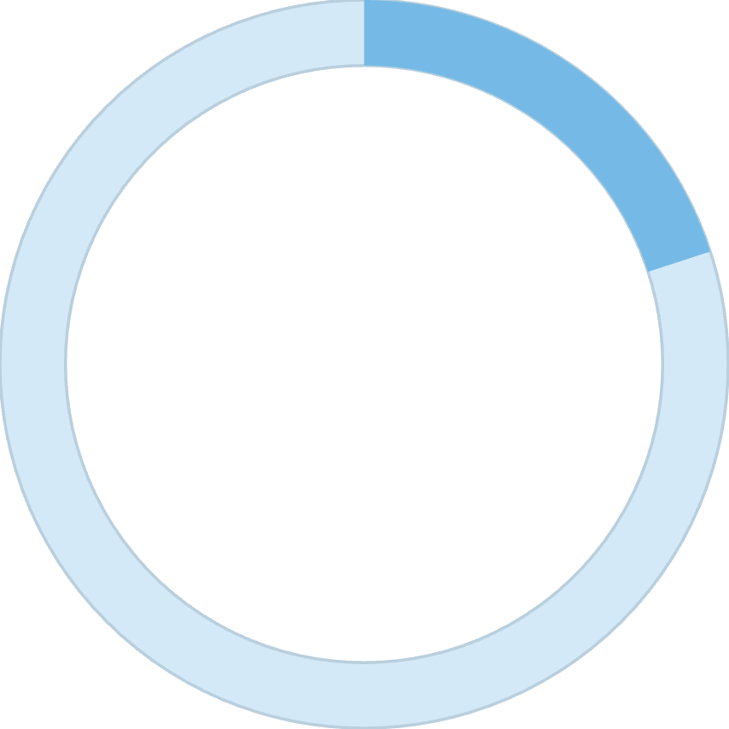

Marketing Innovation in Action
20-40%
100%
Traditional Marketing Spend
Redistributed Value
Typical revenue allocation on advertising platforms, media campaigns, and promotional agencies
Portion redirected toward member incentives, network rewards, and community growth programs
This model transforms members into active ecosystem participants and promoters, creating sustainable growth that benefits all contributors.

Slide 8

From Program to Economic Network
Early Expansion
Self-Sustaining Economy
Community participation drives initial ecosystem adoption
Product sales, travel services, and blockchain utilities create lasting value
1
2
3
Platform Growth
Digital services and software platforms generate commerce
The system evolves into a fully operational ecosystem economy where business activities generate revenue supporting long-term growth rather than relying solely on expansion phases.

Slide 9

Strategic Vision for Global Impact
Building a global digital ecosystem where technology, commerce, and community participation work together to create lasting value.
Global Reach
Expanding across Vietnam, Southeast Asia, and international markets through strategic partnerships.
Technology Innovation
Continuous development of blockchain infrastructure, AI tools, and decentralized applications.
Community Growth
Early contributors helping accelerate adoption of a broader platform economy.

Slide 10

Driving Growth Through Member Participation
Traditional Marketing
Infinity 8 Approach
Relies on significant budgets for advertising networks, agencies, and broad promotional campaigns to acquire users.
Redistributes marketing spend directly into the ecosystem, empowering members to drive adoption and expansion.
This innovative model transforms members into active ecosystem builders, contributing directly to platform growth through:
Member Commissions
Direct financial incentives for introducing new participants and successful referrals.
Community Rewards
Bonuses and recognition for active engagement and contributions to the ecosystem's health.
Participation Incentives
Encouraging active use and sharing of platform services, fostering organic word-of-mouth growth.
Network Expansion Programs
Supporting initiatives that directly grow the ecosystem's reach and user base.
By leveraging its community, Infinity 8 achieves faster, more authentic, and sustainable organic growth than conventional advertising methods.

Slide 11
How Member Investments Are Used
Participation funds are strategically allocated to support the development of the long-term Nirvista ecosystem infrastructure. The goal is to build technology platforms, digital services, and economic systems that create lasting value for all.
Blockchain Infrastructure
Ecosystem Development
AI Trading Protocol
Funds support the Nirvista Blockchain, enabling secure digital transactions, smart contract automation, dApps, and ecosystem token functionality.
Developing the Nirvista marketplace, travel services, and digital services platforms to create real economic activity and unified interactions.
Developing a Safe AI USDT trading protocol for automated liquidity optimization, capital allocation strategies, and stable digital asset management.
Liquidity Infrastructure
Technology Development
Allocating funds to maintain robust liquidity systems, supporting token market stability, ecosystem transaction flows, and exchange environments.
Continuous investment in building SaaS platforms, AI tools, digital infrastructure, and developer tools to create long-term value and revenue.

Slide 12

Existing and Upcoming Revenue Streams
Nirvista is designed as a multi-industry digital ecosystem, not just a network program. The company generates and plans to generate revenue through several business lines.
Software Development Services
Travel and Tourism Business
Digital Services Marketplace
Nirvista already operates as a technology development company providing:
The upcoming Nirvista travel platform will provide:
The Nirvista ecosystem will host a marketplace connecting:
Custom software development
Digital platform solutions
Enterprise technology consulting
Hotel bookings
Travel packages
Tourism services
Service providers
Freelancers
Businesses
These services generate existing revenue streams.
The platform is supported by existing relationships within the travel industry.
Participants will be able to buy and sell digital services within the ecosystem.
Blockchain Utility Services
Strategic Partnerships
Future blockchain-based tools may include:
Nirvista is developing strategic partnerships with businesses in regions including:
Smart contract infrastructure
Blockchain transaction services
Decentralized application support
Vietnam
Southeast Asia
Other international markets
These services provide technology infrastructure to the broader ecosystem.
These collaborations expand the ecosystem’s reach and revenue opportunities.

Slide 13
How Returns and Rewards Are Calculated
The compensation system is designed carefully to ensure long-term sustainability for all participants.
KEY PRINCIPLES
Payout Limits: Implemented to control financial risk and maintain ecosystem stability.
Revenue Protection: Operational reserves are secured before any rewards are distributed.
Balanced Allocation: Funds are strategically divided between essential operations and member rewards.
In the Infinity 8 model, this translates into a robust framework where:
Operational First
Capped Payouts
Rewards are distributed only after operational reserves are secured, safeguarding the ecosystem's future.
Payout ratios are capped within safe limits, ensuring sustainable growth and preventing over-distribution.
To validate the sustainability of the system, financial models are rigorously evaluated using advanced simulation tools. This proactive approach ensures resilience against various market dynamics.
SIMULATION SCENARIOS
1
2
Rapid Growth
Slower Adoption
Modeling scenarios of accelerated user adoption and network expansion.
Analyzing periods of reduced growth to ensure stability and adaptability.
3
4
Market Volatility
Long-Term Expansion
Testing the system's resilience against unpredictable economic fluctuations.
Projecting sustainability over extended periods of ecosystem development.
The objective of these comprehensive simulations is to ensure the program remains stable and robust under diverse conditions, protecting member value.

Slide 14
Financial Stability & Long-Term Vision
Infinity 8 integrates robust financial safeguards and a clear strategy for evolving into a self-sustaining economic network.
Financial Safety Mechanisms
Long-Term Sustainability Strategy
Several safeguards are built into the ecosystem to protect both members and the company:
The Infinity 8 model is designed to evolve into a fully operational ecosystem economy, with platform activity stemming from:
Payout cap limits
Operational reserve funds
Liquidity management systems
Diversified ecosystem revenue streams
Controlled token supply and vesting schedules
Product sales
Digital services
Software platforms
Travel services
Blockchain utilities
Ecosystem transactions
These mechanisms ensure rewards are distributed without threatening financial stability.
These activities generate revenue to support the long-term growth of the ecosystem.

Slide 15

Building Value Together
Not Just Participants
Members are early contributors helping accelerate the adoption of a broader platform economy.
Self-Sustaining Future
As the ecosystem expands, technology innovation, business activity, and community growth reinforce each other.
Real Economic Network
Lasting Value Creation
Platform services, commerce, and technology generating long-term value for all participants.
A self-sustaining digital economy where contributions are rewarded through ecosystem expansion.

