Slide 1
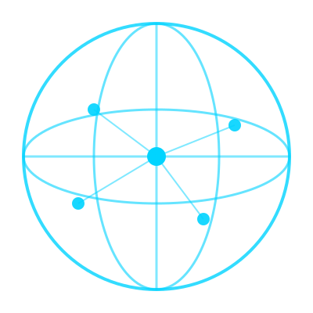
N
NIRVISTA
Building the Future of
Global Payments
Borderless Finance. Instant Global Transactions.
Learn More →
2026 Investor Presentation · Confidential

Slide 2
THE VISION
A World Without
Financial Borders
$190T+
Global Payment Flows Annually
Sources: BIS, McKinsey Global Payments Report 2024
Global money transfers should be as simple as sending a message. Nirvista is building the infrastructure layer that removes friction from international payments — for individuals, businesses, and the global economy.
5B+
Underserved People in Global Finance
Source: World Bank Financial Inclusion Data
"Make cross-border transactions as simple as domestic digital payments"

Slide 3




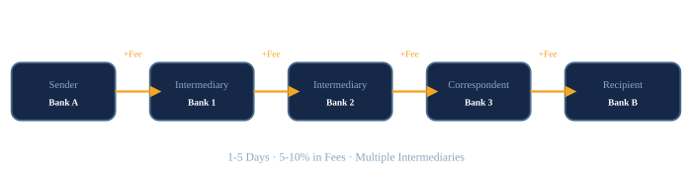
THE PROBLEM
International Payments Are Broken
1–5 Days
5–10%
3–6 Banks
2B+ Excluded
Settlement Time
Transaction Fees
Intermediaries Per Transfer
Unbanked Population
Today's Cross-Border Payment Journey:

Slide 4




MARKET OPPORTUNITY
A Multi-Trillion Dollar Market
Growth Drivers
TAM
$190T
Remote Work Economy
SAM
$10T
1.5B remote workers globally
Global Freelancers
$1.5T+ freelance market
SOM
$500B
Cross-border E-commerce
25% annual growth
Expat Remittances
$860B+ annually

Slide 5
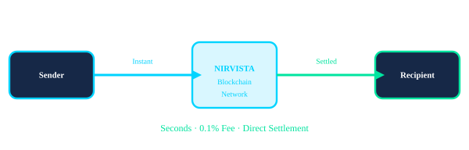
THE SOLUTION
The Nirvista Global Payment Ecosystem
A blockchain-powered global payment network enabling instant, low-cost cross-border transactions through a single, simple digital interface.
Instant Settlement
< 1% Fees
Blockchain Secured
Global Access

Slide 6
PRODUCT CONCEPT
Global Payments as Simple
as Your Local App
Domestic Payments ✓
Cross-Border Today ✗
🇮🇳 India
UPI / PhonePe
✗ 1–5 days settlement time
Nirvista
Bridges
The Gap
🇺🇸 USA
Venmo / Zelle
→
✗ 5–10% fees per transfer
🇬🇧 UK
Monzo / Revolut
✗ 3–6 bank intermediaries
🇨🇳 China
WeChat Pay / Alipay
✗ No unified global app
Instant · Cheap · Easy
Slow · Expensive · Complex

Slide 7



PRODUCT
Nirvista Payment Platform
User Wallet
Global Gateway
Blockchain Layer
Compliance & KYC
FX Liquidity
Multi-currency digital wallet for individuals & businesses
Smart payment routing across 150+ countries
Immutable settlement on distributed ledger
AI-powered identity verification & AML
Real-time currency exchange at institutional rates
1
2
3
4
5

Slide 8
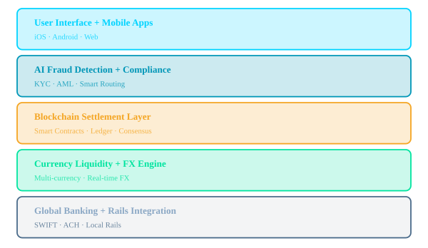



TECHNOLOGY
Blockchain-Powered Infrastructure
Blockchain Ledger
Distributed, immutable transaction record with cryptographic verification across all nodes.
Smart Contracts
Automated execution of payment agreements — no intermediary required.
AI Fraud Detection
Real-time ML models analyzing 100+ risk signals per transaction.
Global Settlement
Sub-second finality across 150+ supported currencies and corridors.

Slide 9
COMPETITIVE ADVANTAGE
Why Nirvista Wins
Feature
Traditional Banks
Remittance Apps
NIRVISTA
Settlement Time
1–5 Days
Minutes–Hours
< 10 Seconds
Transaction Fees
5–10%
2–5%
< 1%
Transparency
Opaque
Partial
Full Blockchain
Global Access
Limited
Select Markets
150+ Countries
AI Security
Basic
Moderate
Advanced ML
Infrastructure
Legacy SWIFT
Centralized
Decentralized Blockchain

Slide 10

BUSINESS MODEL
How Nirvista Generates Revenue
Transaction Fees
Enterprise Integration
0.5–1%
Custom
Per payment processed on the network
White-label payment rails for corporates & fintechs
API Licensing
Merchant Services
SaaS
0.3–0.8%
Financial institutions accessing our infrastructure
Cross-border checkout for e-commerce platforms
Projected Path to $50M ARR by Year 5 · Unit economics improve at scale with blockchain infrastructure

Slide 11


TARGET USERS
Who Benefits From Nirvista
Freelancers
Remote Workers
SME Businesses
1.5B+ freelancers worldwide
500M+ remote employees
400M+ SMEs globally
Get paid instantly from global clients without losing 5%+ in fees
Receive salaries in any currency, spend locally
Pay international suppliers and receive global revenue
E-commerce Sellers
Expats & Diaspora
Global Startups
$6T+ e-commerce market
$860B+ remittance flows
50M+ startups globally
Accept payments globally, settle locally in real-time
Send money home without costly remittance fees
Build on Nirvista APIs to power their own payment products

Slide 12
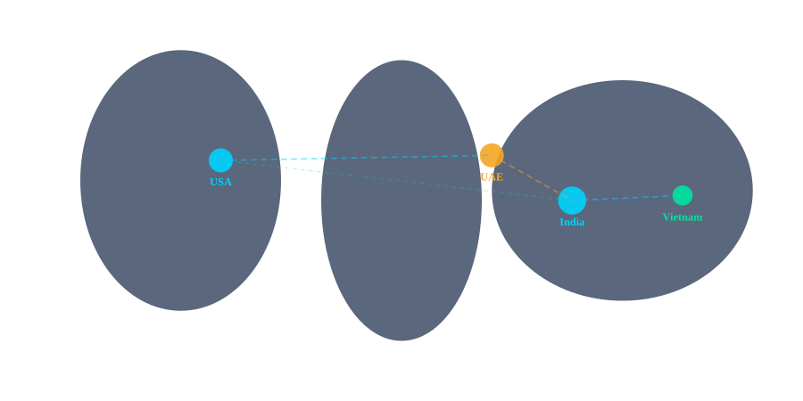
GO-TO-MARKET
Initial Launch Markets
We begin with the world's highest-volume cross-border payment corridors, targeting $4.5T+ in annual flows across our four launch markets.
🇮🇳 India
$100B+ outbound remittances
🇺🇸 USA
$68B+ cross-border business
🇦🇪 UAE
$43B+ annual remittances
🇻🇳 Vietnam
Strategy: Launch in high-volume corridors → Build network density → Expand to 40+ markets by Year 3
$18B+ incoming remittances

Slide 13
GROWTH STRATEGY
Platform Growth Engine
Fintech
Partnerships
API-First
Ecosystem
Co-launch with local fintech apps for instant distribution
Developers build payment products on Nirvista rails
Network
Effect
Merchant
Integrations
Global Wallet
Network
Embed Nirvista in e-commerce checkout flows globally
Cross-border wallet interoperability with 50+ platforms
Target: 10M Users in Year 1 · 100M+ by Year 3 · $1B+ GMV by Year 2

Slide 14
ABOUT US
About Nirvista
2018
2020
2022
2024
2026
Founded
Fintech Pivot
AI & Blockchain
Nirvista Pay
Launch →
Nirvista launched as a software development company in India, UAE, and the US
Shifted focus to financial infrastructure and international payment technology
Launched dedicated practice areas in artificial intelligence and blockchain development
Began development of the Nirvista global payment ecosystem and strategic partnerships
Preparing for pilot launch in India, USA, UAE, and Vietnam corridors
7+
4
50+
100+
Years Building
Digital Products
Countries
Operating
Engineers &
Fintech Experts
Software
Projects Delivered

Slide 15
CAPABILITIES
Core Technology Expertise
Software Engineering
Fintech Infrastructure
› Full-stack development
› Payment gateway dev
› Cloud-native architecture
› Banking API integration
› Microservices & APIs
› PCI-DSS compliance
› DevOps & CI/CD
› Real-time transaction systems
Artificial Intelligence
Blockchain Development
› ML fraud detection
› Smart contract dev
› NLP for compliance
› DeFi protocols
› Predictive analytics
› Layer-2 scaling
› AI-driven automation
› Tokenization platforms

Slide 16
GLOBAL PRESENCE
International Footprint
🇮🇳 India
Engineering HQ
Primary engineering & product
🇺🇸 United States
Business HQ
Sales, strategy & partnerships
🇦🇪 UAE
MENA Hub
Middle East & Africa expansion
🇻🇳 Vietnam
APAC Hub
Southeast Asia operations

Slide 17


LOOKING AHEAD
Building Global Financial
Infrastructure
Unified Global Network
AI-Driven Finance
Borderless Ecosystem
Next-Gen Fintech
One network connecting every financial institution, wallet, and payment rail on the planet.
Intelligent financial services that learn, adapt, and optimize for each individual and business.
A complete financial stack where money moves as freely as data across the internet.
Powering the next generation of financial applications built on open, accessible infrastructure.

Slide 18
ROADMAP
Product Development Roadmap
Phase 1
Phase 2
Phase 3
Phase 4
Q1–Q2 2026
Q3–Q4 2026
2027
2028+
Platform Foundation
Corridor Launch
Global Expansion
Full Ecosystem
In Progress
Upcoming
Planned
Vision
› Core payment infrastructure
› India–USA corridor live
› 40+ country coverage
› DeFi lending products
› Blockchain settlement layer
› UAE–India payments
› Merchant payment APIs
› AI financial advisor
› KYC/AML compliance systems
› Vietnam–US launch
› Enterprise white-label
› Nirvista developer network
› Beta app development
› Fintech partner integrations
› Multi-currency wallets
› IPO readiness

Slide 19
THE OPPORTUNITY
Join the Future of Global Finance
Why Now?
Investment Highlights
1
Blockchain adoption reaching critical mass in financial services
Market Size
$190T+
2
Post-COVID remote work created unprecedented demand for global payments
Target ARR Y5
$50M+
3
Regulatory frameworks maturing across key markets
Gross Margin
70%+
4
Mobile-first Gen Z entering peak earning & spending years
Launch Markets
4 Countries
Seed Round: Open for Discussion

Slide 20
N
NIRVISTA
Borderless Finance for a Connected World
Building the future of global financial infrastructure.
support@nirvista.in · www.nirvista.io

